Slide 1
FILE IO BY CHENCHU KRISHNA

Slide 2
System.IO Namespace
Provides basic file and directory support classes
Contains types that enable you to read and write files and data streams
Many of the types or classes defined as part of the System.IO namespace are designed around streams

Slide 3
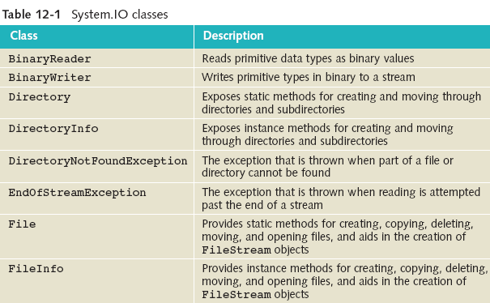
System.IO Namespace (continued)

Slide 4
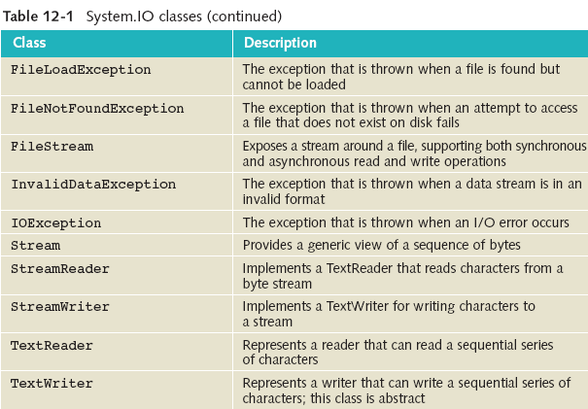
System.IO Namespace (continued)
Many are exception classes that can be thrown while accessing information using streams, files and directories

Slide 5
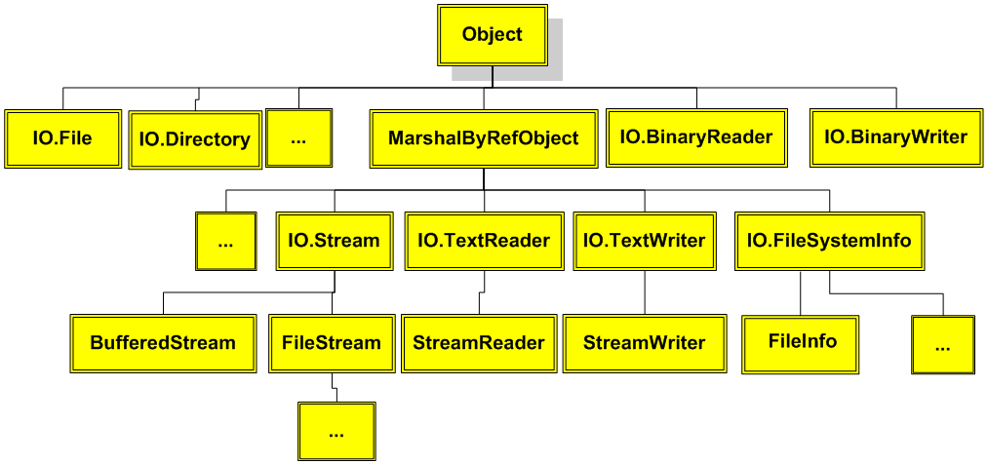
.NET file class hierarchy

Slide 6
File and Directory Classes
Utility classes allow you to manipulate files and directory structures
copying, moving, renaming, creating, opening, deleting, and appending files
Expose only static members
Objects are not instantiated from these classes
To invoke the method, the method name is preceded by the class name (as opposed to an object’s name)
File.Copy(“sourceFile”, “targetFile”);

Slide 7
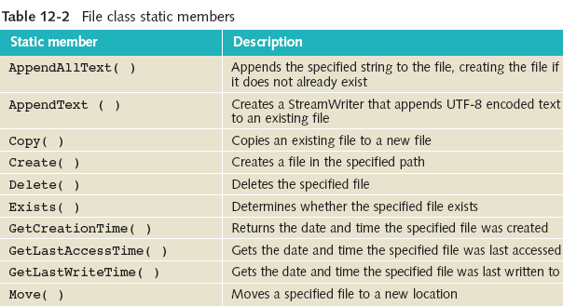
File Class

Slide 8
File Class (continued)
One static method of the File class is Exists( )
Example 12-1
/* DirectoryStructure.cs illustrates using File and Directory utilities. */
using System;
using System.IO;
class DirectoryStructure
{
public static void Main( )
{
string fileName = "BirdOfParadise.jpg";
if (File.Exists(fileName))
{

Slide 9
File Class (continued)
GetAttritubes( ) returns a FileAttributes enumeration
Enumeration is a special form of value type that supplies alternate names for the values of an underlying primitive type
Enumeration type has a name, an underlying type, and a set of fields

Slide 10
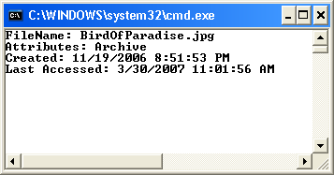
File Class (continued)
GetAttributes( ) returns enumeration
Console.WriteLine( "FileName: {0}", fileName );
Console.WriteLine( "Attributes: {0}", File.GetAttributes(fileName) );
Console.WriteLine( "Created: {0}", File.GetCreationTime( fileName ) );
Console.WriteLine( "Last Accessed: {0}",File.GetLastAccessTime
( fileName ) );
Figure 12-3 Output from the DirectoryStructure application

Slide 11
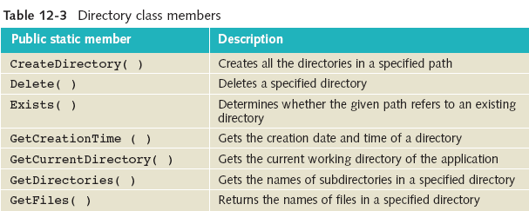
Directory Class
Static methods for creating and moving through directories and subdirectories

Slide 12
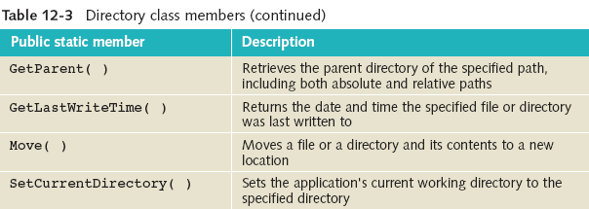
Directory Class (continued)

Slide 13
DirectoryInfo and FileInfo Classes
Add additional functionality beyond File and Directory classes
Difference – Both have instance methods instead of static members
Both have public properties and public constructors
Neither can be inherited

Slide 14
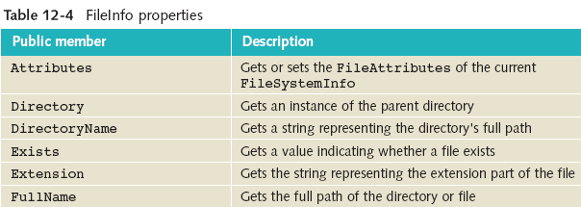
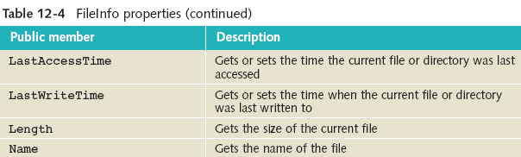

Slide 15
DirectoryInfo
Adds two other key properties, Parent and Root
Parent gets the parent directory of a specified subdirectory
Root gets the root portion of a path
Be careful with paths; they must be well-formed or an exception is raised
DirectoryInfo dir = new DirectoryInfo(".");
Console.WriteLine("Current Directory: \n{0}\n",
Directory.GetCurrentDirectory( ));

Slide 16
File Streams
Several abstract classes for dealing with files
Stream, TextWriter, and TextReader
Stream classes provide generic methods for dealing with input/output
IO.Stream class and its subclasses – byte-level data
IO.TextWriter and IO.TextReader – data in a text (readable) format
StreamReader and StreamWriter derived classes of IO.TextWriter and IO.TextReader

Slide 17
File Streams (continued)
StreamWriter class for write data to text file
Includes implementations for Write( ) and WriteLine( )
StreamReader class to read or and from text files
Includes implementations of Read( ) and ReadLine( )
System.IO namespace
Using System.IO;

Slide 18
File Streams (continued)
StreamWriter outputFile = new StreamWriter("someOutputFileName");
StreamReader inputFile = new StreamReader("someInputFileName");
outputFile and inputFile represent the file stream objects
Actual file names are “someOutputFileName” and “someInputFileName” – inside double quotes
Place file extensions such as .dat, .dta, or .txt onto the end of actual filename when it is created

Slide 19
File Streams (continued)
Use Write( ) or WriteLine( ) with the instantiated stream object
outputFile.WriteLine("This is the first line in a text file");
Use Read( ) or ReadLine( ) with the instantiated stream object
string inValue = inputFile.ReadLine( );

Slide 20
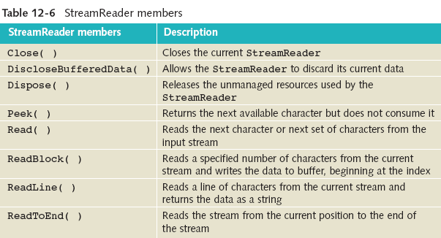
File Streams (continued)

Slide 21
THANKYOU

